Slide 1
Experiments in First Story Detection
Indro De
Dept of Mathematics and Computer Science
Ursinus College, Collegeville, USA
Proc. The National Conference on Undergraduate Research 2005

Slide 2
First Story Detection
Automatically identify the first story on a new event from a stream of text
Topic Detection and Tracking – TDT
  Sponsored by US government agencies
Applications
  Finance: Be the first to trade a stock
  Breaking news for policy makers
  Intelligence services
Other technologies don’t work for this
  Information retrieval
  Text classification
  Why?

Slide 3
Definitions
Story: A news article (describing a single event).
Event: A topic that is reported in a number of stories.
Activity: A connected set of actions that have a common focus or purpose - campaigns, investigations, disaster relief efforts.
Topic: a seminal event or activity, along with all directly related events and activities

Slide 4

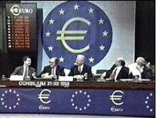
Examples
2002 Presidential Elections
Thai Airbus Crash (11.12.98)
  On topic: stories reporting details of the crash, injuries and deaths; reports on the investigation following the crash; policy changes due to the crash (new runway lights were installed at airports).
Euro Introduced (1.1.1999)
  On topic: stories about the preparation for the common currency (negotiations about exchange rates and financial standards to be shared among the member nations); official introduction of the Euro; economic details of the shared currency; reactions within the EU and around the world.

Slide 5
TDT Tasks
First story detection (FSD)
  Detect the first story describing an event
Topic tracking
  Once a topic has been detected, identify subsequent stories about it
  Standard text classification task
  However, very small training set (initially: 1!)
Linking
  Given two stories, are they about the same topic?
  One way to solve FSD

Slide 6
The First-Story Detection Task
To detect the first story that discusses a topic,
for all topics.
First Stories
= Topic 1
= Topic 2
Time
Not First Stories
There is no supervised topic training
  (like Topic Detection)

Slide 7
First Story Detection
New event detection is an unsupervised learning task
Detection may consist of discovering previously unidentified events in an accumulated collection – retro
Flagging onset of new events from live news feeds in an on-line fashion
Lack of advance knowledge of new events, but have access to unlabeled historical data as a contrast set
The input to on-line detection is the stream of TDT stories in chronological order simulating real-time incoming documents
The output of on-line detection is a YES/NO decision per document

Slide 8
Patterns in Event Distributions
News stories discussing the same event tend to be temporally proximate
A time gap between burst of topically similar stories is often an indication of different events
  Different earthquakes
  Airplane accidents
A significant vocabulary shift and rapid changes in term frequency are typical of stories reporting a new event, including previously unseen proper nouns
Events are typically reported in a relatively brief time window of 1-4 weeks

Slide 9
TDT: The Corpus
TDT evaluation corpora consist of text and transcribed news from 1990s.
A set of target events (e.g., 119 in TDT2) is used for evaluation
Corpus is tagged for these events (including first story)
TDT2 consists of 60,000 news stories, Jan-June 1998, about 3,000 are “on topic” for one of 119 topics
Stories are arranged in chronological order

Slide 10
Tasks in News Detection
News Feeds
Segmentation
Detection
Retro
On-Line
Tracking

Slide 11
Approach 1: KNN
On-line processing of each incoming story
Compute similarity to all previous stories
  Cosine similarity
  Language model
  Prominent terms
  Extracted entities
If similarity is below threshold: new story
If similarity is above threshold for previous story s: assign to topic of s
Threshold can be trained on training set
  Threshold is not topic specific!

Slide 12
Approach 2: Single Pass Clustering
Assign each incoming document to one of a set of topic clusters
A topic cluster is represented by its centroid (vector average of members)
For incoming story compute similarity with centroid

Slide 13
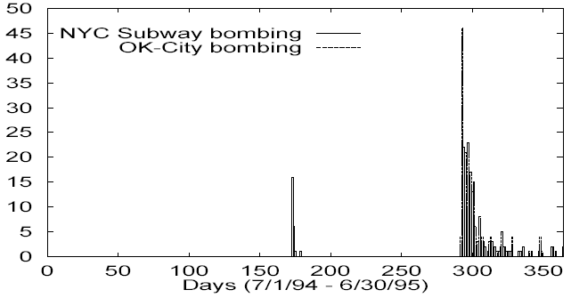
Similar Events over Time

Slide 14

Approach 3: KNN + Time
Only consider documents in a (short) time window
Compute similarity in a time weighted fashion:
m: number of documents in window, d_i: ith document in window
Time weighting significantly increases performance.

Slide 15
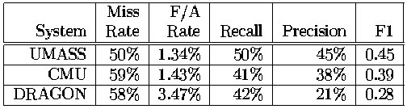
FSD - Results

Slide 16
Discussion
Hard problem
Becomes harder the more topics need to be tracked. Why?
Second Story Detection much easier than First Story Detection
Example: retrospective detection of first 9/11 story easy, on-line detection hard

